Slide 1
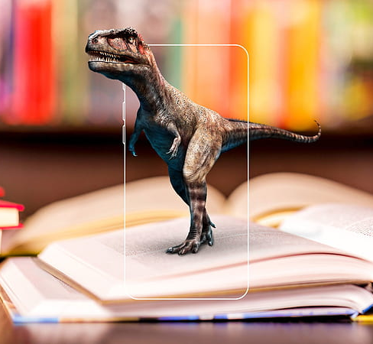
Mobile application based on AR-IoT
Name : Manoj R & Hariharan M V
Reg No : 124006059 &124006058
Guide Name : Ghousiya Begum K

Slide 2

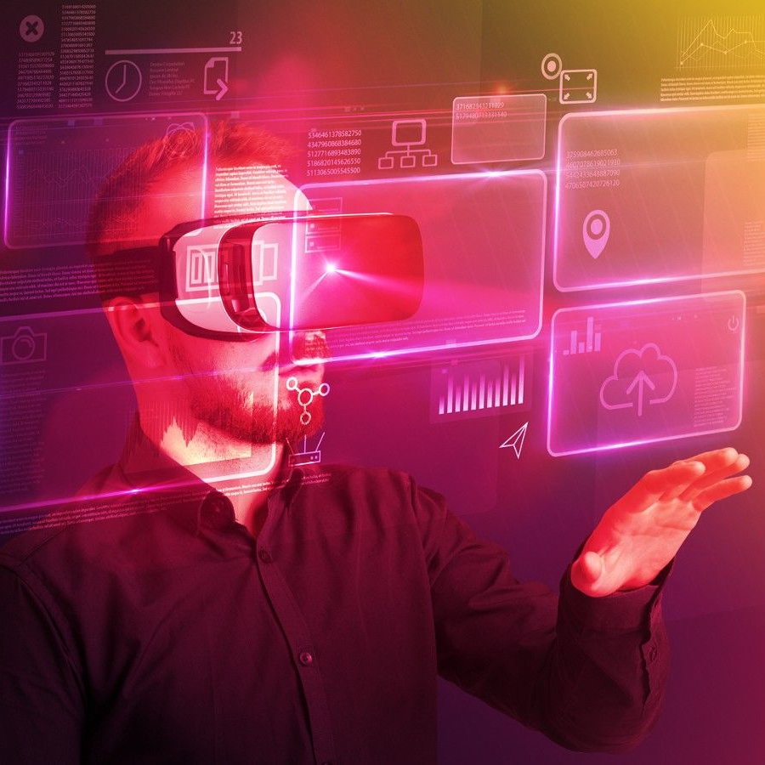

Agenda
Introduction to Mobile Application Based on AR with IoT
Benefits of Mobile Application Based on AR with IoT
Applications of Mobile Application Based on AR with IoT
Challenges of Mobile Application Based on AR with IoT
Conclusion of Mobile Application Based on AR with IoT
Future of Mobile Application Based on AR with IoT

Slide 3
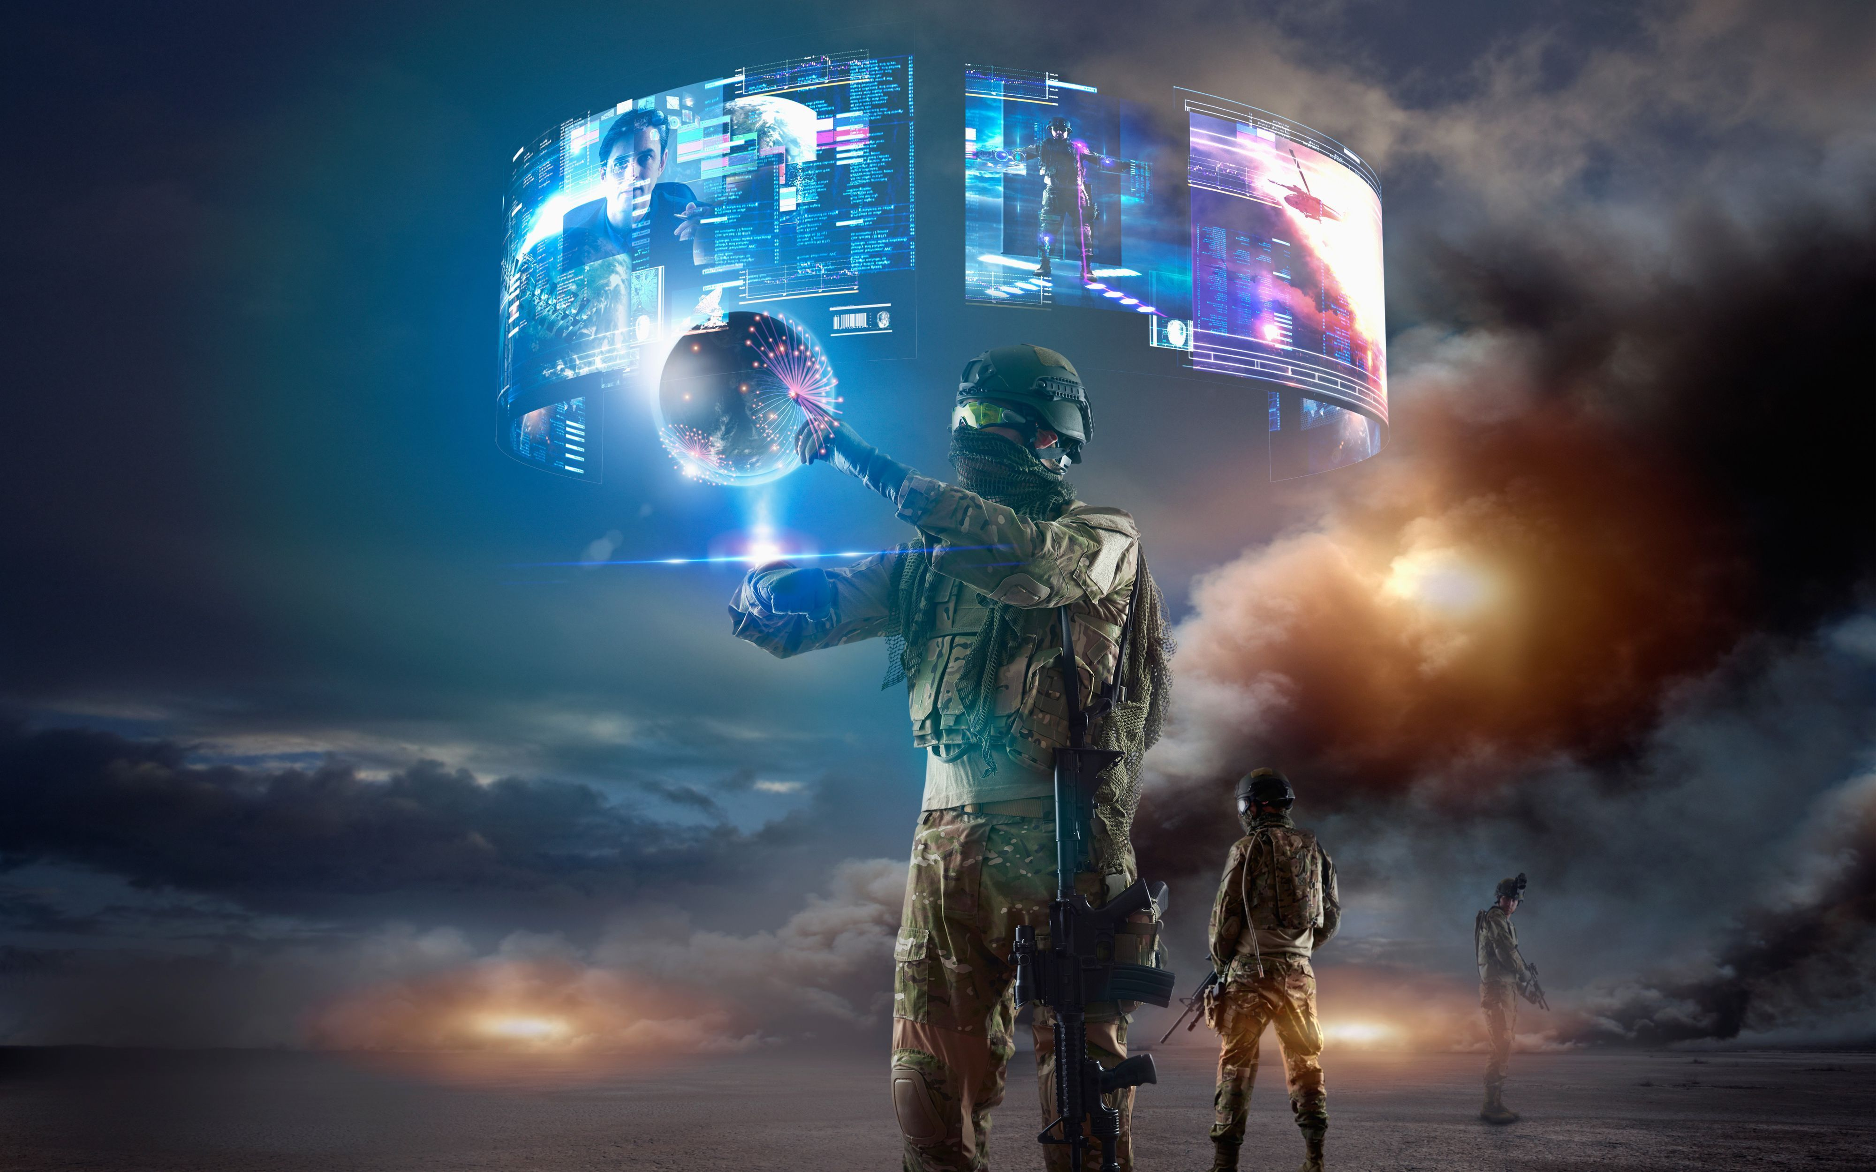

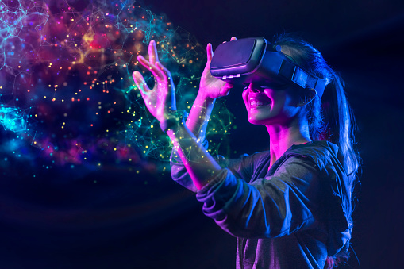

Introduction
The popularity of mobile applications based on augmented reality (AR) as well as the internet of things (IoT) is rising. This technology creates an immersive and participatory experience by fusing the physical and digital worlds. It enables people to engage with their surroundings in a way that was before impossible.
IoT technology makes it possible for physical things to be connected to the internet, enabling data communication and exchange between them. This can be combined with AR to provide a potent tool for interactive experience creation. Users can now interact with real-world items in ways that were previously not feasible because to this technology.

Slide 4

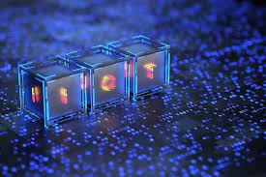
Benefits of Mobile Application Based on AR with IoT
Users can profit from the combination of AR and IoT in a number of ways. It makes it possible for people to engage with their surroundings in a more organic and immersive manner. Users can obtain more information and have more control over their environment by tying physical objects to the internet. Real-time data access is another feature of this technology that enables users to take prompt and precise decisions.
The way organisations run has the potential to change as a result of the convergence of AR and IoT. Businesses can obtain data instantly and make precise judgements by tying physical items to the internet. Customers' experiences can be made immersive and interactive using this technology, which can help to enhance engagement and loyalty

Slide 5
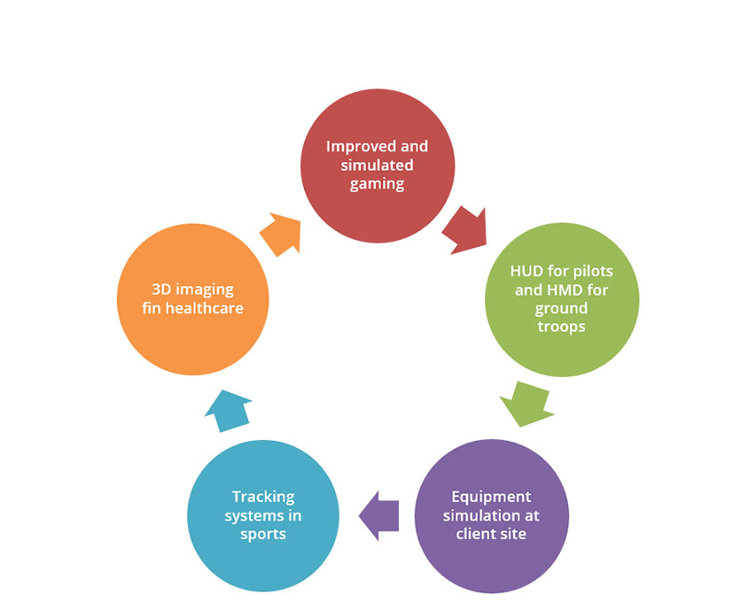
Applications of Mobile Application Based on AR with IoT
There are several uses for AR and IoT across numerous sectors. This technology can be applied to the healthcare sector to develop interactive patient and physician experiences. This technology can be employed in the retail sector to give customers an immersive and engaging experience. This technology can be applied to the automotive sector to develop interactive passenger and driver experiences.
This technology can be applied to the education sector to develop engaging learning environments for both teachers and students. This technology can be applied to the gaming sector to give players engaging and immersive experiences. This technology can be applied to the entertainment sector to give audiences interactive experiences.

Slide 6
Challenges of Mobile Application Based on AR with IoT
There are number of difficulties presented by the fusion of AR with IoT. The necessity for fast internet connectivity is one of the main obstacles. The technology cannot deliver the rich and interactive experiences that users want without a quick connection. The system also needs a lot of data, which may be costly and challenging to handle.
The requirement for high-performance hardware presents another difficulty. The technology cannot deliver the immersive and interactive experiences that users need without powerful hardware. The technology also needs a lot of computational power, which may be costly and challenging to operate.

Slide 7
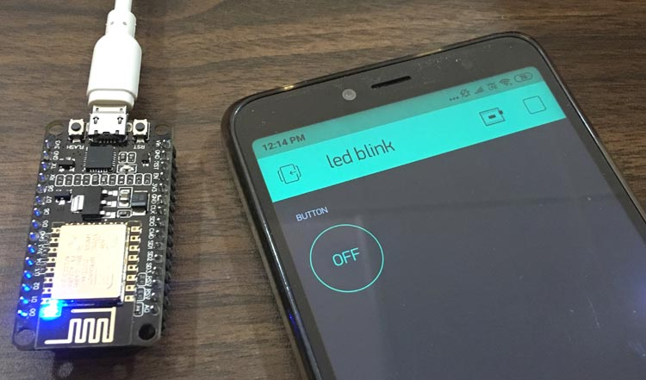
With the ESP8266 Arduino, turn on and off the light
Since it provides a more natural and dynamic method to interact with physical devices than standard IoT devices, augmented reality (AR) is a potent tool for monitoring and managing physical devices like lights, switches, and sensors.
Users don't need to enter their device's settings or make manual adjustments to turn on and off their lights, change the brightness, or set timers using augmented reality.

Slide 8
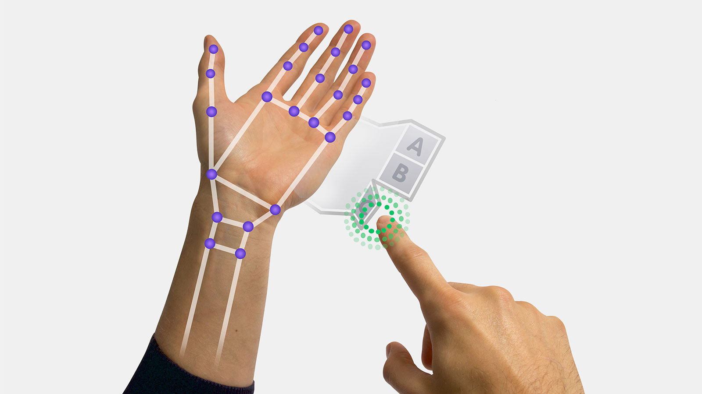

Future of Computer Vision with Hand Tracking
The possibility of computer vision and tracking with hand tracking increases as technology does.
The options are unlimited when it comes to developing a strong, user-friendly mobile experience, ranging from gesture-based control to 3D mapping and beyond.
Utilising the potential of natural language processing and machine learning to usher in a new era of mobile experiences.

Slide 9
Conclusion of Mobile Application Based on AR with IoT
A potent tool for developing immersive and interactive experiences is AR and IoT. I maybe used to develop interactive experiences for clients and audiences, and it has the ability to fundamentally alter the way businesses run. The necessity for sophisticated hardware and high-speed internet connections are only a couple of the difficulties it presents.
Despite these difficulties, the marriage of augmented reality and the internet of things is an exciting and potent technology that has the potential to completely change how we interact with our surroundings. This technology can be utilised to create immersive and engaging experiences that were previously unattainable with the appropriate

Slide 10
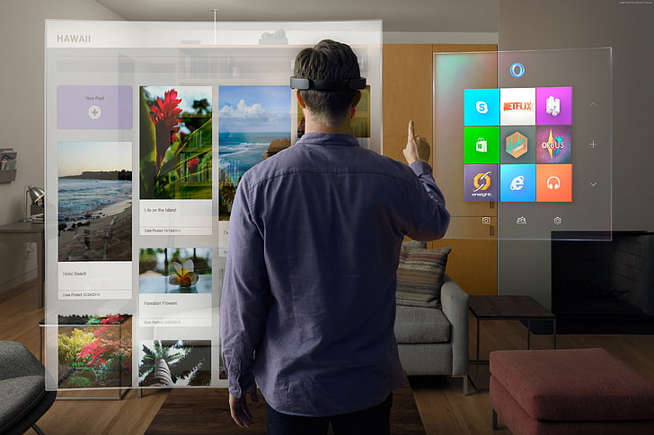
Future of Mobile Application Based on AR with IoT
With the integration of AR and IoT, countless opportunities arise for developers to create innovative and immersive mobile applications.
As the technology advances, mobile applications will become more personalized and interactive, allowing users to experience the world in a whole new way.

Slide 11
References
Subtitle
Subtitle
1. Grant Wilson, I.A. Energy data visualization requires additional approaches to continue to be relevant in a world with greater low-carbon generation. Front. Energy Res. 2016, 4, 33.
2. Hopf, H.; Müller, E. Providing energy data and information for sustainable manufacturing systems by Energy Cards. Robot. Comput. Integr. Manuf. 2015, 36, 76–83.
3. Chou, C.-C.; Chiang, C.-T.; Wu, P.-Y.; Chu, C.-P.; Lin, C.-Y. Spatiotemporal analysis and visualization of power consumption data integrated with building information models for energy savings. Resour. Conserv. Recycl. 2017, 123, 219–229.
4. Chatzopoulos, D.; Bermejo, C.; Huang, Z.; Hui, P. Mobile augmented reality survey: From where we are to where we go. IEEE Access 2017, 5, 6917–6950.
5. Ong, S.K.; Nee, A.Y.C. Virtual and Augmented Reality Applications in Manufacturing; Springer Science & Business Media: Berlin/Heidelberg, Germany, 2013; ISBN 1447138732.

Slide 12


Thank You
Presenter name :
Manoj R.D
Hariharan M V
Department & Year : EIE & 3rd year

